Slide 1

/* * CSC 289 * Project Presentation * 05/10/2021 */
List<Presenter> yourPresenters = new List<Presenter>
{
W.Merritt,
S.Mccartney,
B.Dalton,
S.Apulu
};
Notes:
INTRODUCTIONS //Introduce yourselves
$“Good Afternoon, I’m {myName}”;

Slide 2
//Problem to solve.
Employees
Dealing with inquiries about a product and not having any knowledge about it.
Checking if a product is in stock.
Searching available catalogue
Managers
In/Out processing for employees.
Inventory tracking/updating.

Slide 3
//Proposed Solution
Give Employees access to search for in-store available products and entire catalogue of products via an employee assistant app.
Give Managers ability to track and update inventory. Also
Notes:
Silvia

Slide 4
//Technologies Involved
C# (C-Sharp)
Microsoft Visual Studios 2019
WPF (Windows Presentation Foundation)
XAML (Extensible Application Markup Language
MVVM Structure (Model-View-ViewModel)
Notes:
Will

Slide 5
//Technologies Involved (Cont’d)
Local Database
SQL (Structured Query Language)
Dapper (NuGet)
Material Design (NuGet)
Caliburn.Micro (NuGet)
Notes:
Will

Slide 6
//User Stories
(EPIC)As a Manager, I want to manage inventory and employees.
(User Story) As an owner, I want to give employees different levels of access.
(User Story) As a Manager I want to be able to add, delete, modify employees.
(User Story) As a Manager, I want to add, delete, modify products.
(User Story) As an Employee, I want to search for products
(User Story) As an Employee, I want to view my search results on another screen.
Notes:
Sene

Slide 7
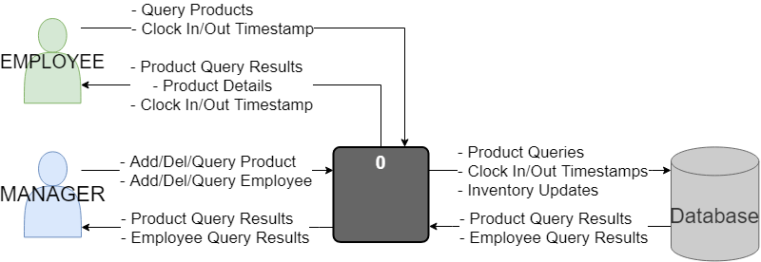
Context Diagram
Notes:
Sene

Slide 8
//Live Demo

Slide 9
//Future Implementations?
Employee clock in/out
Add Recommendation Features
POS System
Add/Deleting Product

Slide 10
//Thank you. <3

